Slide 1
Ecommerce Sales Dashboard
A concise overview of sales performance, profit trends, and customer insights.

Slide 2
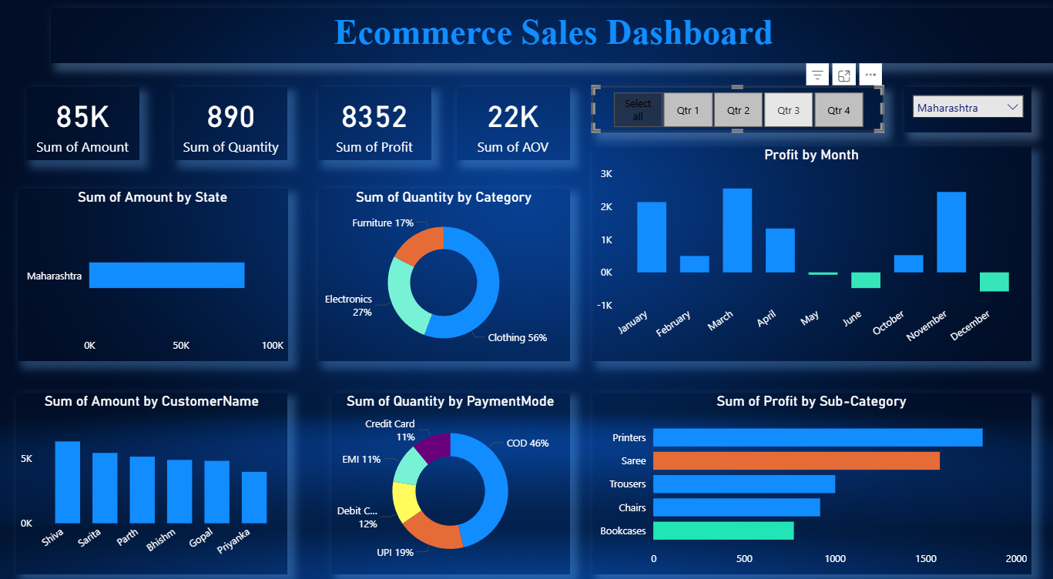

Slide 3
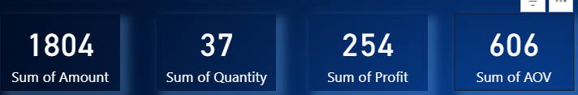
KPI Overview (Executive Summary)
Sum of Amount :- It is indicating the total amount
Sum of Quantity :- It was indicting the total quantity
Sum of Profit :- It was indicating the total profit
Sum of AOV :- It was indicating the total AOV

Slide 4
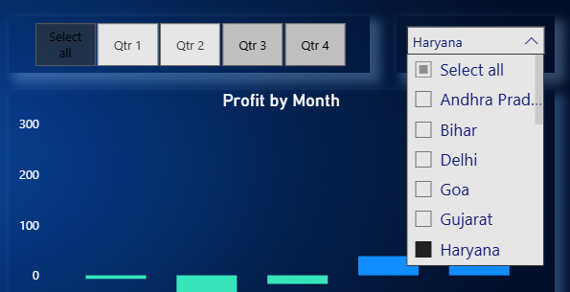
Filters and Segmentation
• Interactive filters for Quarter (Q1–Q4) and State allow focused analysis.
• Insight: Enables easy comparison of performance across periods and locations.

Slide 5
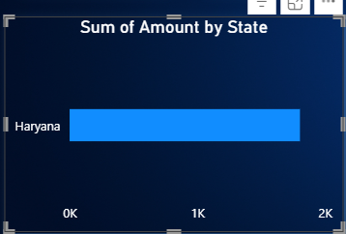
Sum of Amount by State
• X-axis: State
• Y-axis: Total Sales Amount
• Insight: All sales occurred in Haryana (₹1804), suggesting regional concentration.
Expanding to other states could increase reach.

Slide 6
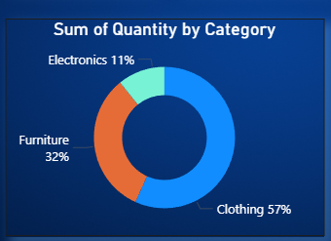
Sum of Quantity by Category
• Each slice represents a product category.
• Insight: Clothing dominates with 57% of sales quantity, followed by Furniture (32%) and
Electronics (11%).Indicates strong demand in apparel.

Slide 7
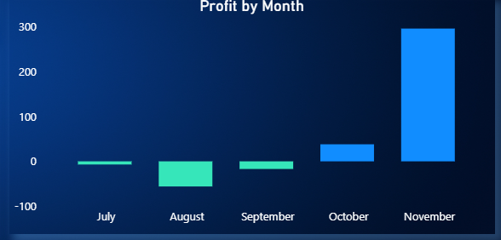
Profit by Month
• X-axis: Months (July–November)
• Y-axis: Profit Amount
• Insight: Profit declined in August but rebounded sharply by November.
Indicates improved seasonal or promotional performance.

Slide 8
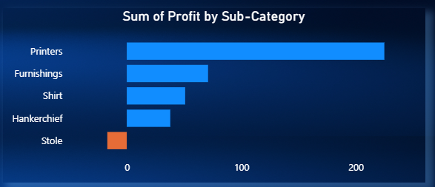
Sum of Profit by Sub-Category
• X-axis: Profit Amount
• Y-axis: Sub-Categories
• Insight: Printers generated the highest profit, while Stole recorded losses.
Product-level strategy can improve low-margin items.

Slide 9
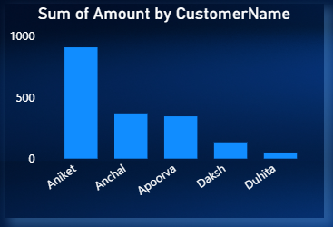
Sum of Amount by Customer Name
• X-axis: Customer Name
• Y-axis: Total Sales Amount
• Insight: Aniket contributed the highest sales (~₹1000).
Indicates potential for loyalty programs for top customers.

Slide 10
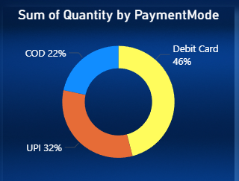
Sum of Quantity by Payment Mode
• Each slice represents a payment mode.
• Insight: Debit Card (46%) is the most used payment method, followed by
UPI (32%) and COD (22%). Shows digital payment preference.

Slide 11
Thank You

